Slide 1
Tutorial 4 – Iterative control modelling of motor adaptation DEADLINE 02/03/2023 23:59pm Pakorn Uttayopas pakorn.uttayopas18@imperial.ac.uk

Slide 2
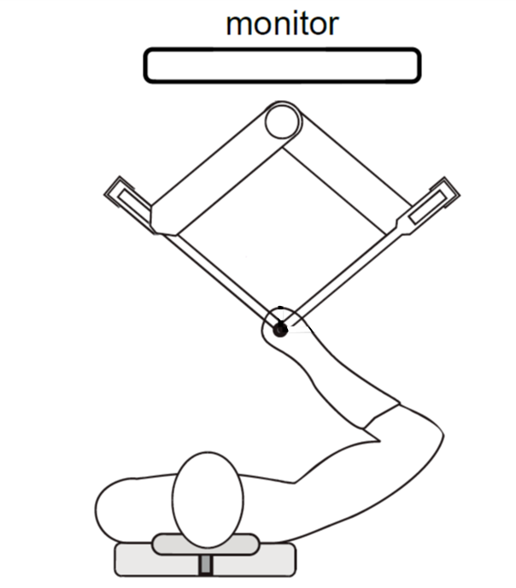
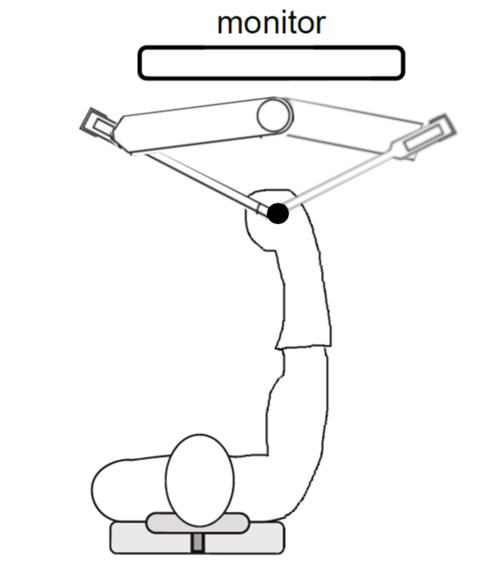
Experiment Setup
End point
Starting point
Starting point
End point
Starting point
Task: point-to-point reaching with a straight reference line
Goal: Investigate how human adapt in an unknown force field

Slide 3



Experiment Force Fields
End point
$$F_{y}=0$$
Starting point
Starting point
$$F_{x}=0$$
Null Field (NF)
$$F=0$$

Slide 4
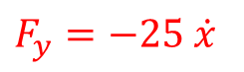
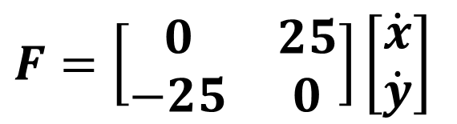
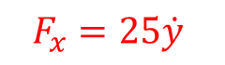
Experiment Force Fields
End point
$$F_{y}=−25 \dot{x}$$
Starting point
Starting point
$$F_{x}=25\dot{y}$$
Velocity-dependent Force Field (VF)
$$F=\left[\begin{matrix}0 & 25 \\ −25 & 0\end{matrix}\right]\left[\begin{matrix}\dot{x} \\ \dot{y}\end{matrix}\right]$$

Slide 5
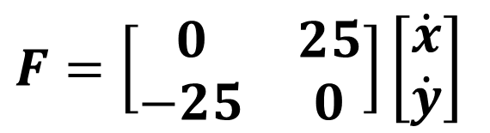
Experiment Force Fields
Velocity-dependent Force Field
$$F=\left[\begin{matrix}0 & 25 \\ −25 & 0\end{matrix}\right]\left[\begin{matrix}\dot{x} \\ \dot{y}\end{matrix}\right]$$

Slide 6
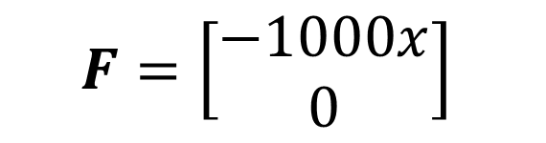


Experiment Force Fields
End point
$$F_{x}$$
$$F_{x}$$
Starting point
Starting point
$$F=\left[\begin{matrix}−1000x \\ 0\end{matrix}\right]$$
Force Channel

Slide 7
Experiment Phases
P.1
Null Field (NF)
32 trials
Velocity-dependent
Force Field (VF)
P.2
127 trials
P.3
Force Channel
150 trials
Velocity-dependent
Force Field (VF)
P.4
12 trials
P.5
Null Field (NF)
26 trials

Slide 8
Experimental results

Slide 9
Experimental results

Slide 10
Question 1: describe experiment results
(a) Describe what is happening to the deviation in different phases.
(b) Justify whether the channel hinders the retention of the motor adaptation in the first VF condition.

Slide 11

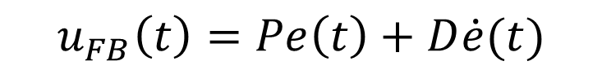
Question 2: computational modelling
A PD feedback controller guides the arm along a predefined straight-line trajectory. If the motion of the arm is disturbed, the controller will send motor commands to the joints to stay along the NF trajectory.
$$u_{FB}\left(t\right)=Pe\left(t\right)+D\dot{e}(t)$$
$$e\left(t\right)=q_{d}\left(t\right)−q(t)$$
If the disturbance is similar trial after trial, these motor commands from the feedback controller can be gradually identified, i.e. a series of feedforward (FF) motor commands can be learned iteratively from the feedback motor commands.
$$u_{FF}{\left(t\right)}^{1}≡0, u_{FF}{\left(t\right)}^{j+1}=αu_{FB}{\left(t\right)}^{j}+\left(1−γ\right)u_{FF}{\left(t\right)}^{j}, j≥1$$

Slide 12
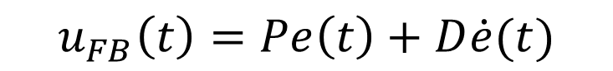
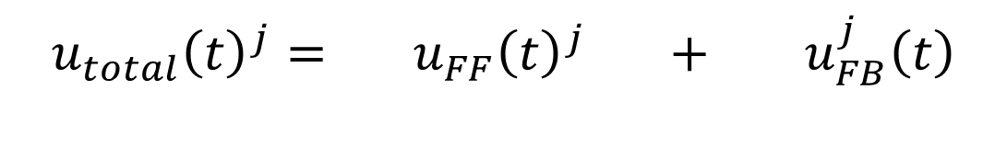
Question 2: computational modelling
The total motor joint command can be represented as:
$$u_{total}{\left(t\right)}^{j}= u_{FF}{\left(t\right)}^{j} + u_{FB}^{j}\left(t\right)$$
Feedforward command
Feedback command
$$u_{FF}{\left(t\right)}^{j+1}=αu_{FB}{\left(t\right)}^{j}+\left(1−γ\right)u_{FF}{\left(t\right)}^{j}, j≥1$$
$$u_{FB}\left(t\right)=Pe\left(t\right)+D\dot{e}(t)$$

Slide 13
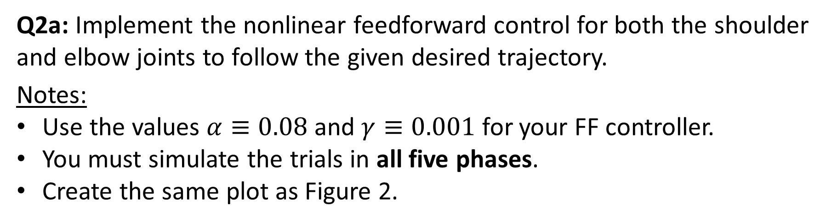
Question 2
Q2a: Implement the nonlinear feedforward control for both the shoulder and elbow joints to follow the given desired trajectory.
Notes:
Use the values $α≡0.08$ and $γ≡0.001$ for your FF controller.
You must simulate the trials in all five phases.
Create the same plot as Figure 2.

Slide 14
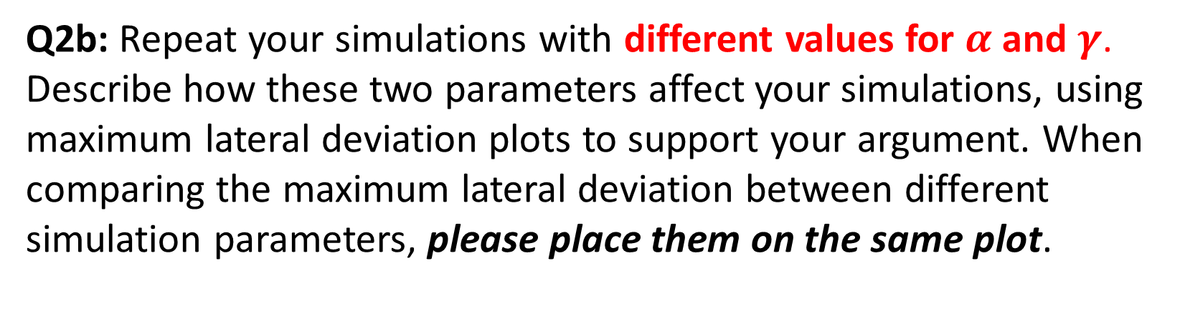
Question 2
Q2b: Repeat your simulations with different values for $α$ and $γ$. Describe how these two parameters affect your simulations, using maximum lateral deviation plots to support your argument. When comparing the maximum lateral deviation between different simulation parameters, please place them on the same plot.
Example

Slide 15
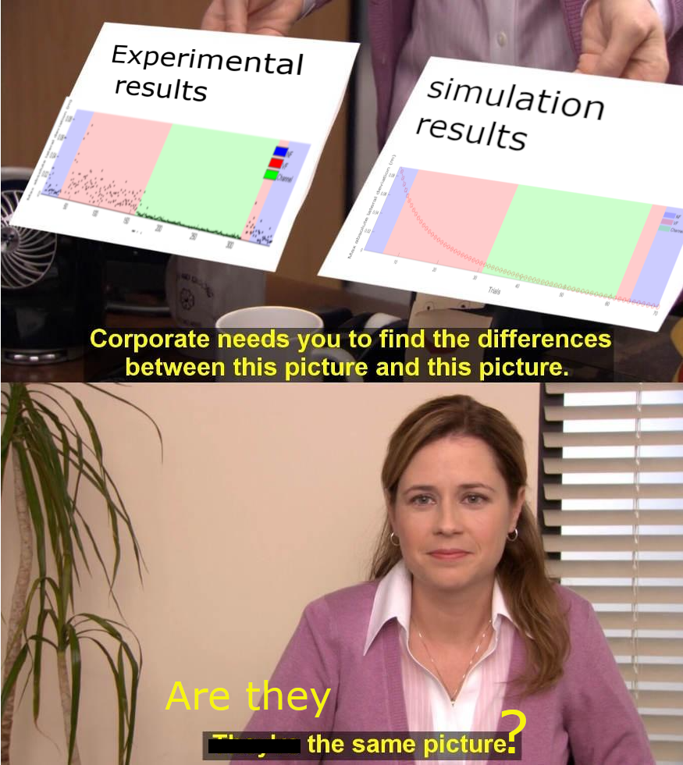
Question 2
Q2c: What is different between the maximum absolute lateral deviation in the experimental results and your simulation in Q2(a) in the washout NF condition? How could the parameters describe this difference? (pay attention to α)

Slide 16
Question 2
MATLAB:
Data file Tutorial 4.mat includes experiment data in five phases
Given main script Tutorial_4.m and auxiliary functions: kin, invKin, Jacobian and mass
The sections of the code that need to be modified are clearly highlight
The loop of operations is very similar to that of Tutorial 3, the difference is that we have added the feedforward component.

Slide 17

Question???

